Slide 1
USafeB: USB Sandbox
Supervised by:
Prof. Dr. Mohamed Abougabal Dr. Ahmed Kosba

Slide 2
Presented by
Abdelarahman Hesham El-Dawy
Ahmad Mahmoud El-Reffaiy
Ahmed Mohamed Ismail
Mohamed Hassan El-Hendy
Rania Khaled

Slide 3
Objectives
Motivation of Project
Related Work
Scope of Work
Time Plan

Slide 4
Agenda
Introduction
Motivation and Attacks
Summary of Related Work
Need to Extend Related Work
Scope of Project
Proposed Solution
Features
Future Extension
Conclusion

Slide 5
Objectives
Motivation of Project
Related Work
Scope of Work
Time Plan

Slide 6
Agenda
Introduction
Motivation and Attacks
Summary of Related Work
Need to Extend Related Work
Scope of Project
Proposed Solution
Features
Future Extension
Conclusion

Slide 7
Introduction
[1]
Basic Definitions
Information security's primary focus is the balanced protection of the confidentiality, integrity and availability of data (also known as the CIA triad) while maintaining a focus on efficient policy implementation.
Confidentiality
Integrity
Data Availability

Slide 8
Introduction (Cont’d)
[1]
Middleware
Sandboxing
Isolation concept
Extra layer of security
Prevention of malware or harmful applications

Slide 9


Slide 10
Agenda
Introduction
Motivation And Attacks
Summary Of Related Work
Need To Extend Related Work
Scope Of Project
Proposed Solution
Features
Future Extension
Conclusion

Slide 11
2. Motivation and Attacks
[2]
Universal Serial Bus (USB) peripherals indispensable part of humanity’s lives
Widely used by individuals and organization
It’s popularity only makes threat more severe
Commonly used peripherals become dangerous attack vectors.

Slide 12
2. Motivation and Attacks (Cont’d)
[3]
USB Hardware
A
C
Programmable Microcontrollers
B
Electrical
USB Peripherals
Rubber Ducky - 2010
USB Killer
B.1
B.2
Maliciously Re-programmed Peripherals
Not Re-programmed Peripherals
DNS Override by modified USB firmware - 2014
.LINK Stuxnet
Virtual machine break-out - 2014

Slide 13
A. Reprogrammable microcontroller USB attacks
[3]
By reprogramming the USB device's internal microcontroller. The device looks like a USB device (e.g.: charger) but carries out the operations of another (e.g.: keyboard —injects keystrokes).

Slide 14
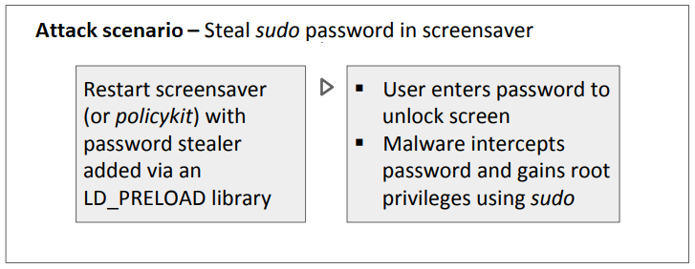
Keyboard Emulation Attacks
[3]
Keyboard emulation is enough for infection and privilege escalation.
USB Rubber Ducky
programmed using Ducky Script: simple and in all caps, each command on new line
possible to achieve specific actions with relatively little code

Slide 15
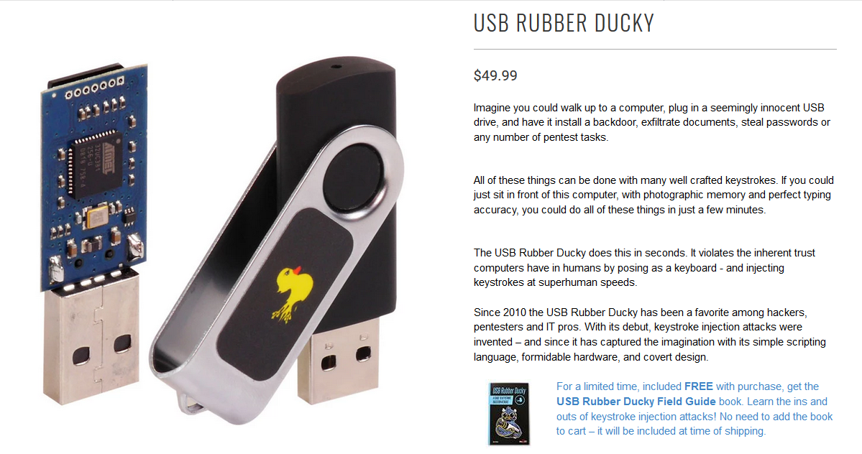
[3]

Slide 16
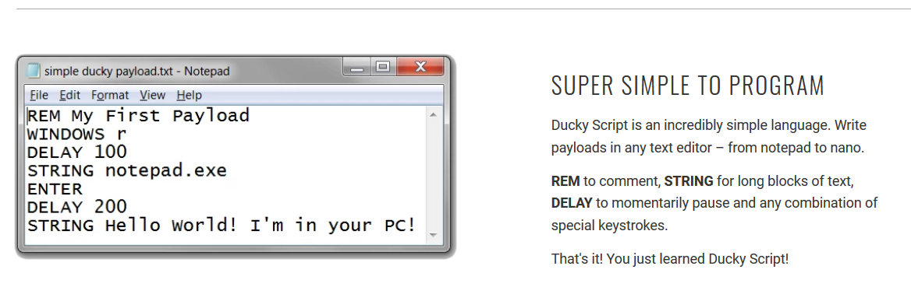
[3]

Slide 17
B1. Maliciously reprogrammed USB peripheral firmware
[3]
By reprogramming the USB device's firmware to execute malicious actions (such as malware downloading, data exfiltration, etc.).

Slide 18
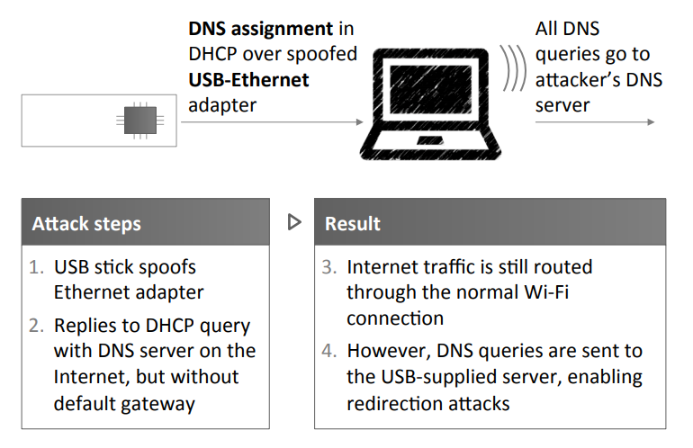
Default gateway override by Modified USB Firmware
[3]

Slide 19
B2. Attacks based on unprogrammed USB devices
[3]
By not reprogramming USB device firmware but leveraging flaws in how operating systems normally interact with USB protocols/standards.

Slide 20
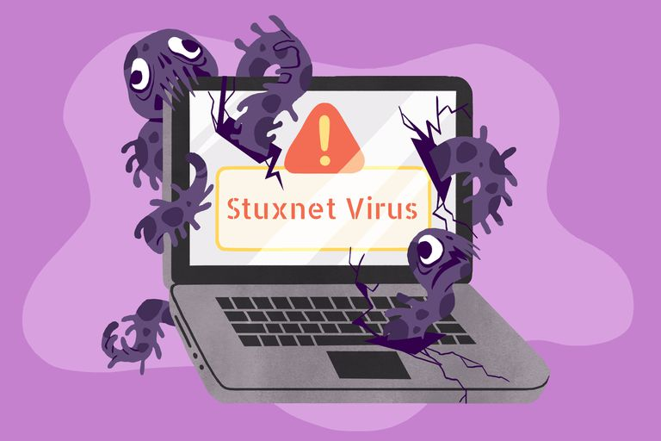
Stuxnet
[4]
Stuxnet is a malicious computer worm, first uncovered in 2010, thought to have been in development since at least 2005.
Stuxnet targets SCADA systems and is believed to be responsible for causing substantial damage to Iran's nuclear program.

Slide 21
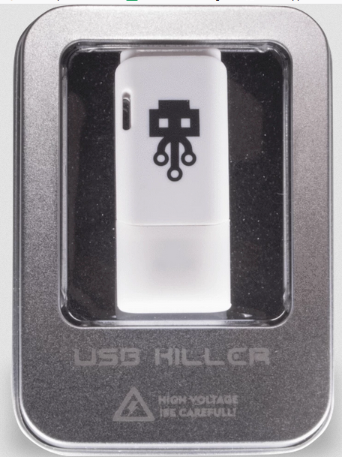
C. USB-based electrical attacks
[3]
USB Killer
According to USBKill.com, a company based in Hong Kong that designed the device, USB Killer 2.0 works by collecting power from the USB power lines (5V, 1 - 3A) until it reaches ~ -240V. It then begins discharging its stored voltage multiple times per second.
The recharge/discharge cycle lasts if USB Killer 2.0 is connected to a USB port. Indeed, it will continue until it can't discharge any longer, that is, when the device has damaged its host's circuitry.

Slide 22
Objectives
Motivation of Project
Related Work
Scope of Work
Time Plan

Slide 23
Agenda
Introduction
Motivation and Attacks
Summary of Related Work
Need to Extend Related Work
Scope of Project
Proposed Solution
Features
Future Extension
Conclusion

Slide 24
3. Summary of Related Work
Several approaches have been made to protect systems from attacks transmitted by USB devices, these approaches can be categorized into host-based solution, middleware solutions, hardware modifications to the peripherals themselves as well as hybrid approaches. Firstly, by examining end-point solutions, GoodUSB [5] relies on user identification of the device, and LBM [6] requires kernel-level modifications at the host-system. Hardware modifications such as Kells[12] and ProvUSB[13] might be able to successfully trample the underlying issues of USB peripherals, however, they would necessitate the deployment of new devices.

Slide 25
3. Summary Of Related Work (Cont’d)
Existing middleware solutions rely on intermediate hardware, such as SandUSB[9] which scans and analyzes USB packets through a Raspberry Pi2 with additional modules installed, and USBWall[10] which uses a BeagleBone Black with USBProxy on board. Another approach is USBCheckin[11], which forces user interaction before allowing a device to interface with the host, an approach that is only functional against a limited range of attacks.

Slide 26
Attribute | Classification | Technique | Focus Issue
GoodUSB [5] | Host-based | User identification of the connected device | General
LBM [6] | Host-based | Kernel modification of the host system | General
USBeSafe [7] | Host-based | Machine-learning based solution | General
FirmUSB [8] | Host-based | Vetting device firmware | General
Uscramble [9] | Host-based | Lightweight encryption | Eavesdropping

Slide 27
Attribute | Classification | Technique | Focus Issue
USBGuard [10] | Host-based | Framework for implementing USB authorization policies | Whitelisting
USBProxy [11] | Host-based | Allows filtering of incoming USB packets via user-defined rules | General
Kells [12] | Hardware | Low-level USB architectural changes | Securing USB design
ProvUSB [13] | Hardware | Low-level USB architectural changes | Securing USB design
DeviceVeil [14] | Hybrid (Host-based and Hardware) | A modified PUF IC attached to USB peripheral | Bi-directional authentication

Slide 28
Attribute | Classification | Technique | Focus Issue
Cinch [15] | Middleware | Attaches peripherals to a logically separate machine with an interposition layer. | General
SandUSB [16] | Middleware | Relaying USB packets from USB to PC | General
USBWall [17] | Middleware | Runs USBProxy as on a physical middleware | General
USBCheckIn [18] | Middleware | Forcing user interaction to verify integrity of device | Spoofing
Proposed Solution | Middleware | Relaying USB packets | General

Slide 29
Agenda
Introduction
Motivation and Attacks
Summary of Related Work
Need to Extend Related Work
Scope of Project
Proposed Solution
Features
Future Extension
Conclusion

Slide 30
4. Need to Extend Related Work
Gap exists between protection solutions, ease of deployment and affordability.
Goal to provide affordable middleware solution against USB-based attacks
easily deployed by anyone
fully platform-independent
without compromising on being secure
It is possible that a user would want to retrieve files from a knowingly malicious storage device without compromising themselves. In order to achieve that, there must be a method in which data can be identified and selectively transferred in a format which does not harm the USB host.

Slide 31
Objectives
Motivation of Project
Related Work
Scope of Work
Time Plan

Slide 32
Agenda
Introduction
Motivation and Attacks
Summary of Related Work
Need to Extend Related Work
Scope of Project
Proposed Solution
Features
Future Extension
Conclusion

Slide 33
5. Scope of Project
Signature-based defenses
Protection against driver vulnerabilities
Payload matching
Device blacklisting or limiting

Slide 34
5. Scope of Project
Achieve platform independence.
Implement a mechanism that allows users to safely retrieve non-malicious files from malicious drives.
Isolating malicious drives and preventing them from harming the host device

Slide 35
Agenda
Introduction
Motivation and Attacks
Summary of Related Work
Need to Extend Related Work
Scope of Project
Proposed Solution
Features
Future Extension
Conclusion

Slide 36
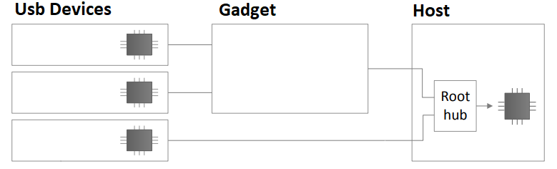
6. Proposed Solution
Using middleware between untrusted USB device and host
adding layer of isolation by emulating USB device on Raspberry PI.

Slide 37
Agenda
Introduction
Motivation and Attacks
Summary of Related Work
Need to Extend Related Work
Scope of Project
Proposed Solution
Features
Future Extension
Conclusion

Slide 38
7. Features
USB Information Profiling
All the information of the USB (Brand, HID … etc.) will be collected and analyzed for suspected attacks
Device Blacklisting
Harmful devices identifiers will be saved into the gadget and it will be automatically denied in future.

Slide 39
7. Features (Cont’d)
Payload Matching
Matching all types of evil code and detect them.
USB Policy
Extra USB policies will be enforced to ensure maximum protection for the host.
Cloud Signature-Based Defenses
A series of defensive mechanisms are layered in order to protect data and information.

Slide 40
7. Features (Cont’d)
Files Isolation
Retrieving files from a knowingly malicious storage device
Driver Vulnerabilities Defense
Realtime defense against vulnerabilities.
Platform Independent
Ability to work on all types of operating systems.
Price
Available in cheaper price than existing solutions.

Slide 41
Feature | SandUSB [16] | USBGuard [10] | Cinch [15] | GoodUSB [5] | USBWall [17] | USBFilter [19] | Proposed Solution | Motive
USB Information Profiling | ✓ | x | x | ✓ | ✓ | x | ✓ | Collecting useful information for analysis purposes
Keyboard Dynamics | ✓ | x | x | x | x | x | x | Irrelevant problem
Device Blacklisting | ✓ | ✓ | x | ✓ | ✓ | ✓ | ✓ | To increase performance, we blacklist previously known malicious devices
Platform Independent | ✓ | x | ✓ | ✓ | x | x | ✓ | To increase the usability of the tool

Slide 42
Feature | SandUSB [16] | USBGuard [10] | Cinch [15] | GoodUSB [5] | USBWall [17] | USBFilter [19] | Proposed Solution | Motive
Payload Matching | ✓ | x | ✓ | ✓ | x | ✓ | ✓ | To make use of well-known attack signatures to defend against them
OS Segmentation | ✓ | x | ✓ | ✓ | x | x | x | Irrelevant problem
USB Policy | ✓ | ✓ | ✓ | ✓ | ✓ | ✓ | ✓ | Adding some pre-built policies to ensure maximum safety for user
Signature- Based Defenses | x | x | ✓ | x | x | x | ✓ | Using +30 online scanners to deeply analyze the suspected binaries

Slide 43
Feature | SandUSB [16] | USBGuard [10] | Cinch [15] | GoodUSB [5] | USBWall [17] | USBFilter [19] | Proposed Solution | Motive
Authentication and Encryption | x | x | ✓ | x | x | x | x | Orthogonal problem
Driver Vulnerabilities Defense | x | x | ✓ | x | x | x | ✓ | Driver vulnerability attacks had a great share of USB attacks recently
Limiting USB Device Functionalities | x | x | x | x | x | ✓ | x | Our hardware design prevents us from applying this feature

Slide 44
Agenda
Introduction
Motivation and Attacks
Summary of Related Work
Need to Extend Related Work
Scope of Project
Proposed Solution
Features
Future Extension
Conclusion

Slide 45
8. Future Extension
Defenses should be implemented against newer attacks, such as ones emerging from hidden partition attacks that allow covert data exfiltration.
USB firmware might break out of virtual environments. In a middleware implementation that makes use of virtual containers, it is essential to further investigate these types of attacks.
Effort should be placed into protecting the middleware itself. There is further work to be done in defending and cleansing the middleware in case of infection.

Slide 46
Objectives
Motivation of Project
Related Work
Scope of Work
Time Plan

Slide 47
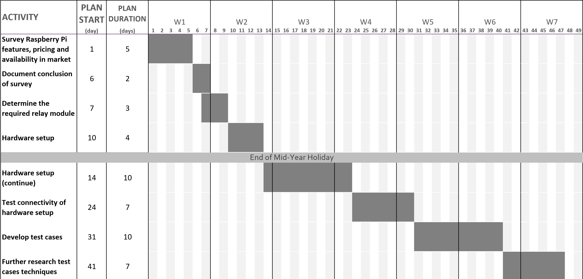

Slide 48
Agenda
Introduction
Motivation and Attacks
Summary of Related Work
Need to Extend Related Work
Scope of Project
Proposed Solution
Features
Future Extension
Conclusion

Slide 49
9. Conclusion
Universal Serial Bus (USB) drives became more prominent attack vector
Traditional endpoint protection mechanisms do not protect against various attacks
Need arises for affordable middleware solution

Slide 50
References
[1] Andress, J. (2014). The Basics of Information Security: Understanding the Fundamentals of InfoSec in Theory and Practice. Syngress. p. 240.
[2] K. Nohl, S. Krißler and J. Lell, "BadUSB — On accessories that turn evil," in BlackHat, 2014.
[3]https://www.bleepingcomputer.com/news/security/heres-a-list-of-29-different-types-of-usb-attacks/
[4]https://www.csoonline.com/article/3218104/what-is-stuxnet-who-created-it-and-how-does-it-work.html
[5] D. J. Tian, A. Bates, and K. Butler, “Defending against malicious USB firmware with GoodUSB,” in Annual Computer Security Applications Conference, ser. ACSAC’15, 2015.

Slide 51
References (Cont’d)
[6] D. J. Tian, G. Hernandez, J. Choi, V. Frost, P. Johnson, and K. Butler. “LBM: A Security Framework for Peripherals within the Linux Kernel. In Proceedings ``'' IEEE Symposium on Security and Privacy (Oakland’19)”, San Francisco, CA, May 2019.
[7] A. Kharraz, B. L. Daley, G. Z. Baker, W. Robertson, and E. Kirda, “USBESAFE: An End-Point Solution to Protect Against USB-Based Attacks”, in 22nd International Symposium on Research in Attacks, Intrusions, and Defenses (RAID), 2019.
[8] G. Hernandez, F. Fowze, D. J. Tian, T. Yavuz, and K. R. B. Butler, “Firmusb: Vetting USB device firmware using domain informed symbolic execution,” in Proceedings of the 2017 ACM SIGSAC Conference on Computer and Communications Security (CCS), Dallas, TX, USA, October 30 - November 03, 2017, 2017

Slide 52
References (Cont’d)
[9] Neugschwandtner, Matthias & Beitler, Antown & Kurmus, Anil. (2016). A transparent defense against USB eavesdropping attacks. 1-6. 10.1145/2905760.2905765.
[10] “USBGuard software framework” https://usbguard.github.io/
[11] “USBProxy-legacy” https://github.com/usb-tools/USBProxy-legacy
[12] K. R. B. Butler, S. E. McLaughlin, and P. D. McDaniel, “Kells: A Protection Framework for Portable Data,” in Annual Computer Security Applications Conference, ser. ACSAC’10, 2010.
[13] Dave (Jing) Tian, Nolen Scaife, Adam Bates, Kevin Butler, and Patrick Traynor, Making USB great again with USBFILTER, 25th USENIX Security Symposium (USENIX Security 16) (Austin, TX), USENIX Association, August 2016, pp. 415–430.

Slide 53
References (Cont’d)
[14] K. Suzaki, Y. Hori, K. Kobara, M. Mannan, “DeviceVeil: Robust Authentication for Individual USB Devices Using Physical Unclonable Functions” 49th Annual IEEE/IFIP International Conference on Dependable Systems and Networks (DSN). 2019.
[15] S. Angel, R. S. Wahby, M. Howald, J. B. Leners, M. Spilo, et al. Defending against Malicious Peripherals with Cinch. In USENIX Security Symposium, Aug. 2016.
[16] E. L. Loe, H.-C. Hsiao, T. H.-J. Kim, S.-C. Lee, and S.-M. Cheng, “SandUSB: An installation-free sandbox for USB peripherals,” in IEEE 3rd World Forum on Internet of Things (WF-IoT), Dec 2016, pp.621–626.

Slide 54
References (Cont’d)
[17] M. Kang and H. Saiedian, “USBWall: A novel security mechanism to protect against maliciously reprogrammed USB devices,” Information Security Journal: A Global Perspective, vol. 26, no. 4, pp. 166–185, 2017
[18] F. Griscioli, M. Pizzonia and M. Sacchetti, "USBCheckIn: Preventing BadUSB attacks by forcing human-device interaction," 2016.
[19] Dave (Jing) Tian, Nolen Scaife, Adam Bates, Kevin Butler, and Patrick Traynor, Making USB great again with USBFILTER, 25th USENIX Security Symposium (USENIX Security 16) (Austin, TX), USENIX Association, August 2016, pp. 415–430.

Slide 55
Thank You
Any Questions?

